Slide 1
双边讨论类议论文

Slide 2
同不同意
讨论类Argumentation
讨论两个观点
讨论利弊
大作文题型
报告类
Report
结合类
Combination

Slide 3
学习要点
1.双边讨论类议论文题目特征
2.双边讨论类题目分析（折中）：思路+语言
3.双边讨论类题目分析（有偏向）：思路+语言

Slide 4
1.双边讨论类议论文题目特征
a. Some people say that advertising is extremely successful at persuading us to buy things. Other people think that advertising is so common that we no longer pay attention to it. Discuss both views and give your own opinion. C15T3
b. Some people say that the only reason for learning a foreign language is in order to travel to or work in a foreign country. Others say that these are not the only reasons why someone should learn a foreign language. Discuss both these views and give your own opinion. C11T3

Slide 5



2.双边讨论类题目分析
Some people say that advertising is extremely successful at persuading us to buy things. Other people think that advertising is so common that we no longer pay attention to it. Discuss both views and give your own opinion. C15T3
messages repeated several times brainwash people
compare and contrast strategies
make products stand out
showing people having a good time together when using a particular product

Slide 6
2.双边讨论类题目分析（折中）
文章框架：
首段：（背景）+引出话题+复述题目观点
主体段1：一方观点+论证
Plenty of people do not like the idea of …. According to their theory, …. More importantly, ….
主体段2：另外一方观点+论证
There are others who are very enthusiastic about …. They are interested in …. It is significant for another reason, too. …
结尾段：立场中立

Slide 7
2.双边讨论类题目分析（折中）
Some people say that advertising is extremely successful at persuading us to buy things. Other people think that advertising is so common that we no longer pay attention to it. Discuss both views and give your own opinion. C15T3
（首段）Advertisement has always been a crucial part in the world of marketing. Throughout the decade, we have seen a significant increase in the amount of advertisements, whether it is on the media like television or widespread through social network platforms. The goal of advertisements is to get consumers to buy a targeted product, and while this method has been proven considerably successful generally, some people view it as too prevalent to catch the consumers' attention any more.

Slide 8
2.双边讨论类题目分析（折中）
Some people say that advertising is extremely successful at persuading us to buy things. Other people think that advertising is so common that we no longer pay attention to it. Discuss both views and give your own opinion. C15T3
（主体段1）Advertisements can act as a strong persuasion device to seemingly hypnotize people into buying goods and services. This is so because of the tactics placed in the messages, such as showing people having a good time together when using a particular product, using bandwagon, showing only the upsides of usage, and applying compare and contrast strategies to show the effects of using the product and make it stand out. Even if people do not know it, these messages are repeated several times and soon it may brainwash people to finally go out and get the product. For instance, if a person is watching television and sees a certain advertisement of a snack many times, the repeated sight of the scrumptious food may result in that person feeling hungry and succumbing to the advertisement at last.
Notes:
If you are hypnotized by someone or something, you are so fascinated by them that you cannot think of anything else. 使着迷
If you describe food as scrumptious, you mean that it tastes extremely good. 极其可口的
If you succumb to temptation or pressure, you do something that you want to do, or that other people want you to do, although you feel it might be wrong. (向诱惑、压力) 屈服

Slide 9
2.双边讨论类题目分析（折中）
Some people say that advertising is extremely successful at persuading us to buy things. Other people think that advertising is so common that we no longer pay attention to it. Discuss both views and give your own opinion. C15T3
（主体段2）Nevertheless, there is another point of view in which the widespread of advertisements makes it a normal thing. After watching a dozen of advertisements people will see it as a mere every day routine and cease to pay attention to the message of the advertisement. Some people may even choose to turn off a television channel, for instance, only just to avoid seeing and hearing repetitive advertisements. After a certain frequency, they start to get bored and stop paying attention to ads. Hence, in the end, the main goal of advertisements is not completed since the people whom the messages are sent out to do not receive that message. A real life example can be seen from advertisements in a particular social media platform, Youtube. In the Youtube marketing mechanism, advertisements are placed before and in between videos, hoping that the viewers would also be forced to watch the advertisements, too. However, this is not usually the case, since many people would just click "Skip Ad" and continue on.
Notes:
If you cease to do something, you stop doing it. 停止; 不再 (做某事)

Slide 10
2.双边讨论类题目分析（折中）
Some people say that advertising is extremely successful at persuading us to buy things. Other people think that advertising is so common that we no longer pay attention to it. Discuss both views and give your own opinion. C15T3
（结尾段）In conclusion, advertisements can be successful in persuading people to purchase goods and services, or they can be unsuccessful in many ways. They are very commonly seen nowadays, but not all of them fulfill their purpose. Thus, advertisements must be designed and presented in the correct way to result in the highest effectiveness.

Slide 11
2.双边讨论类题目分析（折中）
para 4
表达“两者都重要/两者需要结合”的语料:
1） These two opinions do not necessarily contradict each other, but can be adopted simultaneously.
2） I believe that ... and ... play equally important roles, so they should co-exist in ....
3） I believe that a combination of ... and ... is an ideal strategy of ....
4） I believe that the joint effort of ... and ... is the key to ...(doing sth).
表达“需要分类讨论”的语料:
Perhaps it is possible for ... to ...(do sth) and for others not to. It will depend on the situation of ... or ....

Slide 12
2.双边讨论类题目分析（折中）
文章框架性句子仿写对应练习题：
2020.10.17 全球化/双边型
Some people think that importing the foreign films is better for the domestic cultures. However, others believe that producing domestic films is better for local cultures. Discuss both views and give your own opinion.

Slide 13
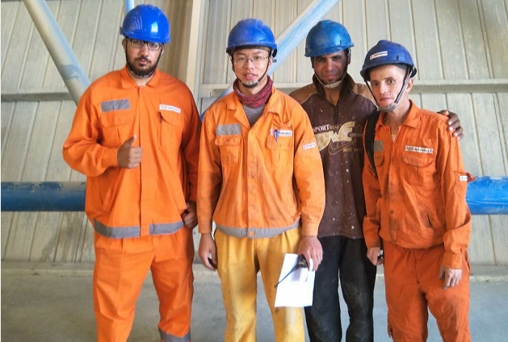

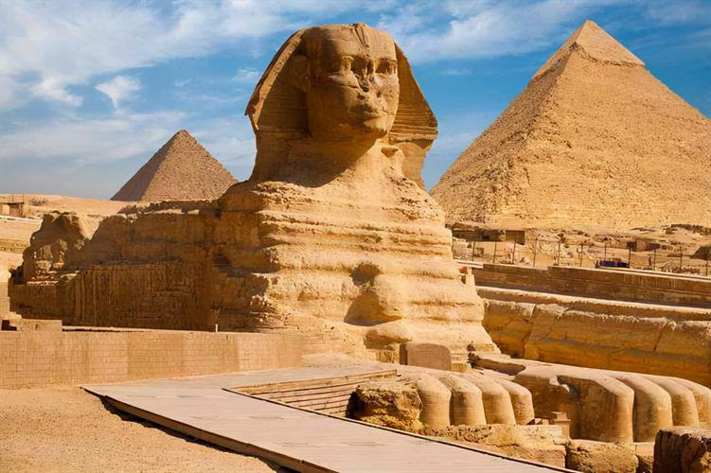

3.双边讨论类题目分析
Some people say that the only reason for learning a foreign language is in order to travel to or work in a foreign country. Others say that these are not the only reasons why someone should learn a foreign language. Discuss both these views and give your own opinion. C11T3

Slide 14
3.双边讨论类题目分析（有偏向）
文章框架：
首段：反方观点+自己的观点（反对对方的想法）
主体段1：反方观点+反方观点分论点1或分论点1+2；反驳
Admittedly, it is reasonable for some to …. Since …, …. Besides, ….
However, the aforementioned detriments can in effect be minimised as long as ….
主体段2：我方观点+分论点1+分论点2
As a matter of fact, .... It is only when … that can sb .... Additionally, ….
结尾段：重申我方观点，只要是满足前提条件（主体段1已提及）
To sum up, on the premise that …, the downsides of … pale into insignificance when set against the upsides.

Slide 15
3.双边讨论类题目分析（有偏向）
Some people say that the only reason for learning a foreign language is in order to travel to or work in a foreign country. Others say that these are not the only reasons why someone should learn a foreign language. Discuss both these views and give your own opinion. C11T3
（首段）
Many may say..., and I agree that today’s society has almost erased all its boarders and soon will become limitless in what concerns travelling for both work and pleasure. Therefore, if this is to happen, then learning a new language is necessary.

Slide 16
3.双边讨论类题目分析（有偏向）
Some people say that the only reason for learning a foreign language is in order to travel to or work in a foreign country. Others say that these are not the only reasons why someone should learn a foreign language. Discuss both these views and give your own opinion. C11T3
（主体段1 他人观点+反驳）
Nowadays, learning a new language for the purpose of working in other countries seems to become popular. Adults in need of money or not, recognition are trying to pursue their happiness far away from home. Also, the hey days of employers looking only for capable people have gone. It seems that today’s employers are looking not only for multi-skilled employees, but they also want people who know more than their mother tongue. Sonner or later, those who omitted learning more are prone to become jobless.

Slide 17
3.双边讨论类题目分析（有偏向）
Some people say that the only reason for learning a foreign language is in order to travel to or work in a foreign country. Others say that these are not the only reasons why someone should learn a foreign language. Discuss both these views and give your own opinion. C11T3
（主体段2）
However, to my mind, a new language should not be learned just for travelling or working in a foreign country. A foreign language should help the learner broaden his mind. By this I mean that the new language should and will allow us to understand more about the world itself, and maybe our ancestors’ ways of thinking and acting. Needless to say, knowing another language will help us when it comes to understanding the human race, because language is the first poem of a country.

Slide 18
3.双边讨论类题目分析（有偏向）
Some people say that the only reason for learning a foreign language is in order to travel to or work in a foreign country. Others say that these are not the only reasons why someone should learn a foreign language. Discuss both these views and give your own opinion. C11T3
（结尾段）
All of this being said, I believe that learning a different language should be not only for satisfying our physical needs, like money, but also our moral needs, because never before had such a big thirst for knowledge been displayed.

Slide 19
3.双边讨论类题目分析（有偏向）
文章框架性句子仿写对应练习题：
2022.01.20 全球化/双边型
Some people think the increasing business and cultural contact between countries brings many positive effects. Others say it causes the loss of national identities. Discuss both views and give your own opinion.

Slide 20
homework
2020.12.31 职场就业/双边型
Directors in organizations receive higher salaries than ordinary workers. Some people think it is necessary but others think it is unfair. Discuss both views and give your opinion.

